Slide 1
Introduction to Software Engineering
Instructor: Mehroze Khan

Slide 2
What is Software?
Software is:
instructions (computer programs) that when executed provide desired features, function, and performance
data structures that enable the programs to adequately manipulate information
documentation that describes the operation and use of the programs.

Slide 3
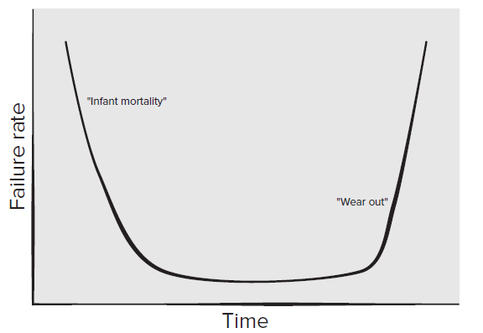
Failure Curve for Hardware

Slide 4
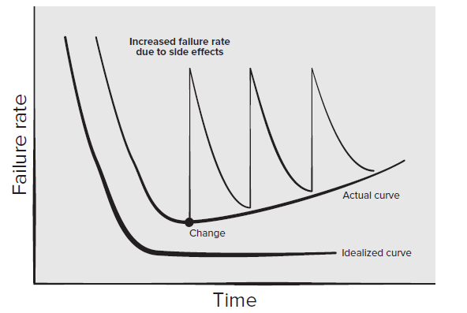
Failure Curve for Software
Software doesn't "wear out“. But it does deteriorate!

Slide 5
Why is SE Needed?
Computers everywhere
Toaster, Microwave, Temperature control of A/C, Router, Surgical Equipment…
Computers need to be managed
Software runs on all computers
Make lives comfortable, efficient, effective…
SE practices ensure development of good software to improve our living standard

Slide 6
Why Do We Need to Study SE?
What could be the benefits?

Slide 7
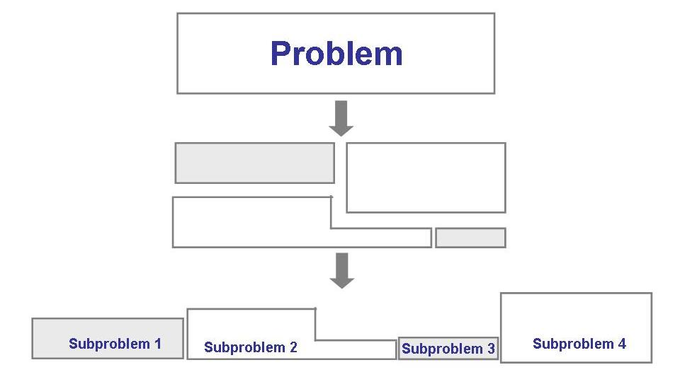
Solving Problems
Analysis

Slide 8
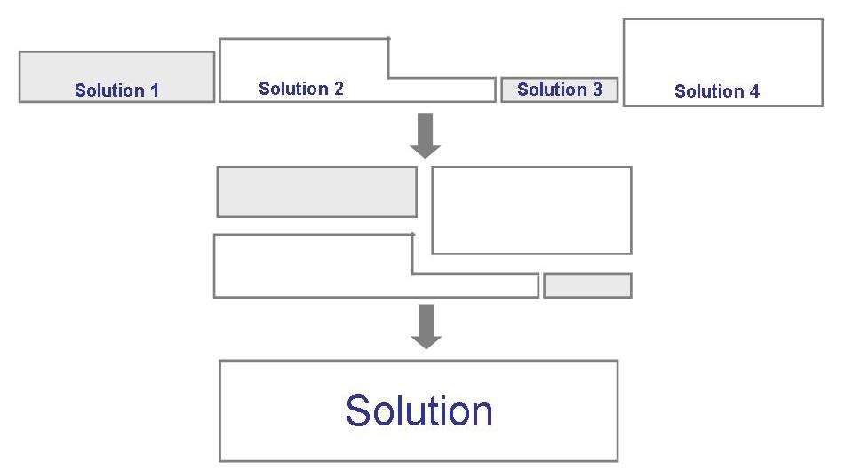
Solving Problems (continued)
Synthesis

Slide 9
Legacy Software
Why must it change?
software must be adapted to meet the needs of new computing environments or technology.
1
software must be enhanced to implement new business requirements.
2
software must be extended to make it interoperable with other more modern systems or databases.
3
software must be re-architected to make it viable within a network environment.
4

Slide 10
Software?
Computer programs along with associated configuration data and documentation s.t. the programs are correctly operated
Configuration data helps set up the programs
System documentation helps understand structure of the system
User documentation explains how to use the system
Notes:
configuration data might include network settings, user preferences, software configurations, and hardware settings.

Slide 11
Engineering?
Engineers’ Job?
Make things work
Apply theories, methodologies, tools appropriately
Provide solutions in absence of applicable theories and methods
Realize financial and organizational constraints

Slide 12
Aspects of Software Production?
Technical process of developing software
Activities such as management of project and teams
Development of tools, theories, methods to support production of software

Slide 13
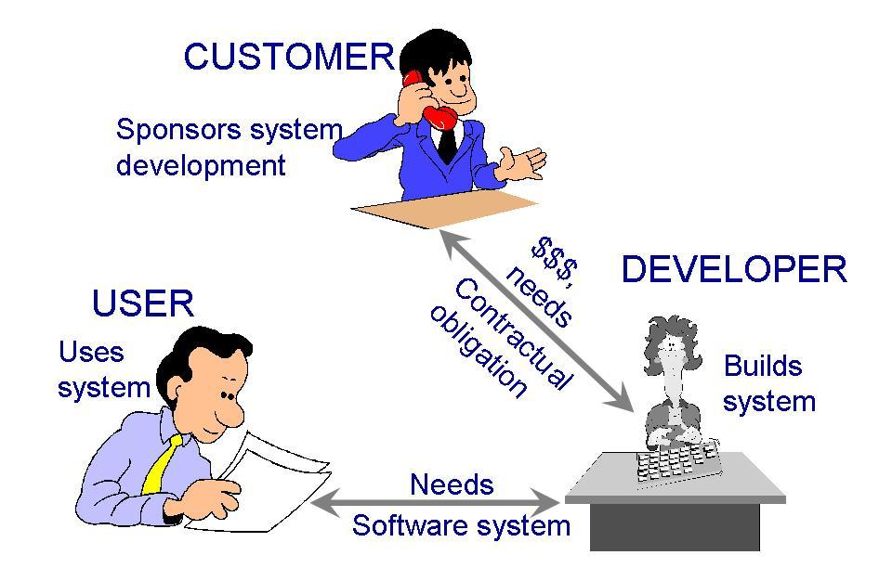
Who Does Software Engineering?
Participants (stakeholders) in a software development project

Slide 14
Development Team
Requirement analysts: work with the customers to identify and document the requirements
Designers: generate a system-level description of what the system is supposed to do
Programmers: write lines of code to implement the design
Testers: catch faults
Trainers: show users how to use the system
Maintenance team: fix faults that show up later
Librarians: prepare and store documents such as software requirements
Configuration management team: maintain correspondence among various artefacts
Notes:
Software artifacts are tangible representations of software-related information. They can include source code, documentation, test plans, and other materials that are used to develop, maintain, and operate software systems

Slide 15
Development Team (Roles)
Who Does What?

Slide 16
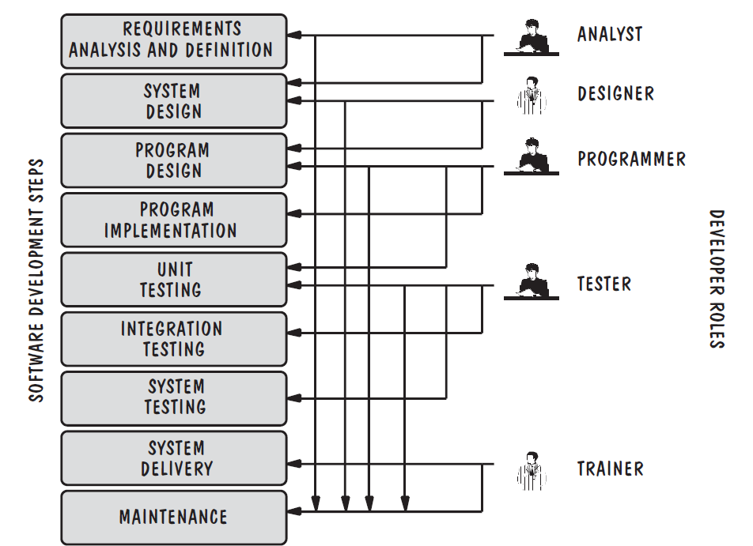
Development Team (Roles)

Slide 17
Paradigm
Resources
Software Engineering
Process
Skillset
Lifecycle
Requirements Analysis | Design | Coding | Testing | Deployment | Maintenance
Typical phases in lifecycle of software

Slide 18
Software Lifecycle
Phases
Requirements analysis and definition
System (architecture) design
Program (detailed/procedural) design
Writing programs (coding/implementation)
Testing: unit, integration, system
System delivery (deployment)
Maintenance

Slide 19
Software Engineers?
Adopt a systematic and organized approach, effectively, to produce high quality software

Slide 20
What is a Good Software Product?
Good software engineering must always include a strategy for producing quality software
Product Quality?
Multiple facets…

Slide 21
What is a Good Software Product?
Users judge external characteristics (e.g., correct functionality, number of failures, type of failures)
Designers and maintainers judge internal characteristics (e.g., ease of modification)
Thus, different stakeholders may have different criteria
Need quality models

Slide 22
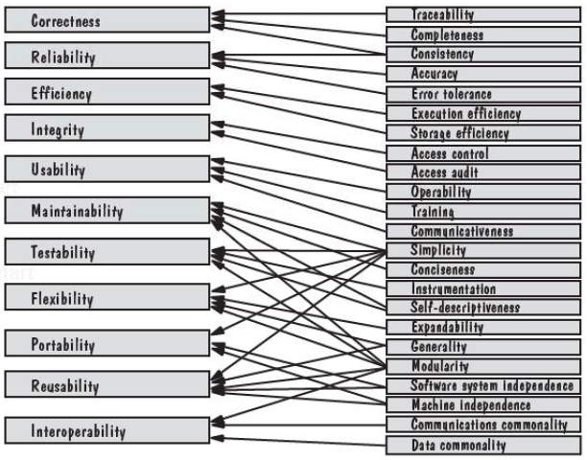
McCall’s Quality Model
Notes:
external quality factors (on the left-hand side) relate to product quality criteria (on the right-hand side)

Slide 23
Lehman’s Laws
(1974) "Continuing Change" — A system must be continually adapted or it becomes progressively less satisfactory. It happens so until it becomes economical to replace it by a new or a restructured version
(1974) "Increasing Complexity/Entropy" —Complexity/entropy of a system increases with time, unless work is done to maintain or reduce it
(1991) "Continuing Growth" — the functional content of a system must be continually increased to maintain user satisfaction over its lifetime
(1996) "Declining Quality" — the quality of a system will appear to be declining unless it is rigorously maintained and adapted to operational environment changes

Slide 24
Software Engineering Challenges
Acceptable Quality
Usability
Security
Reliability
Performance
Cost Effectiveness
Engineering and operational feasibility
Limited development budget
Timely Completion
Limited time
Conflicts?
Manage Conflicts…

Slide 25
Software Engineering
Disciplined, consistent, and systematic effort to construct (design + build) and maintain good quality software in timely and cost-effective manner

Slide 26
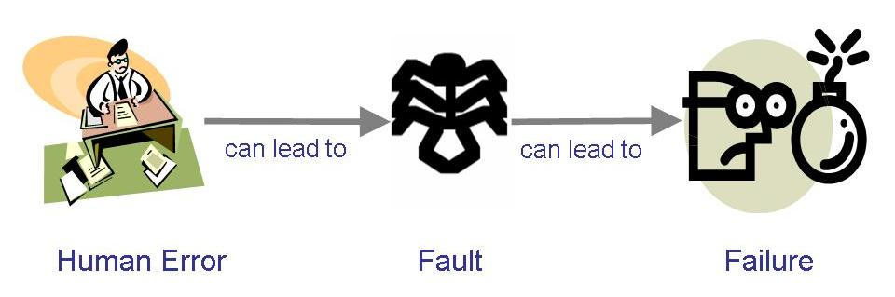
Terminology for Describing Bugs
A fault: occurs when a human makes a mistake, called an error, in performing some software activities
A failure: is a departure from the system’s required behaviour

Slide 27
Elements of a System
Activity: An activity is something that happens in a system. Usually described as an event initiated by a trigger, the activity transforms one thing to another by changing a characteristic.
Objects: The elements involved in the activities are called objects or entities.
Relationships: Once entities and activities are defined, we match the entities with their activities. The relationships among entities and activities are clearly and carefully defined.
System Boundary:
Who generates input and who receives output
Which objects/activities are part of the system and which are not
Nested systems, related systems, interrelated systems

Slide 28
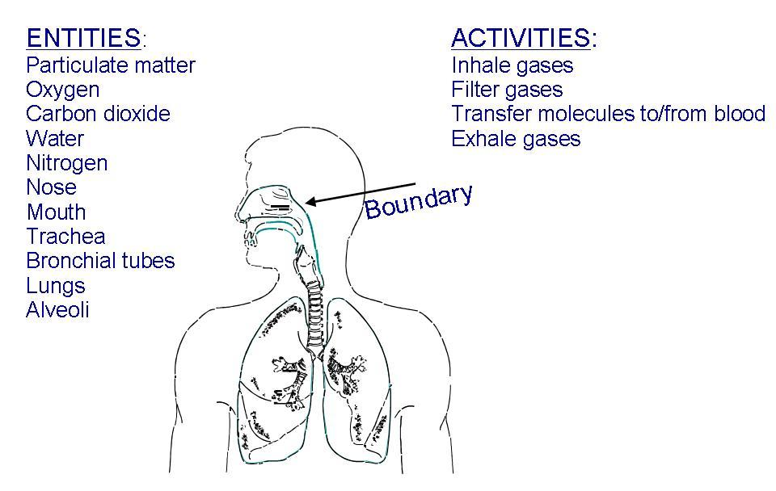
A Systems Approach (Contd.)
Example of systems: a human respiratory system
??

Slide 29
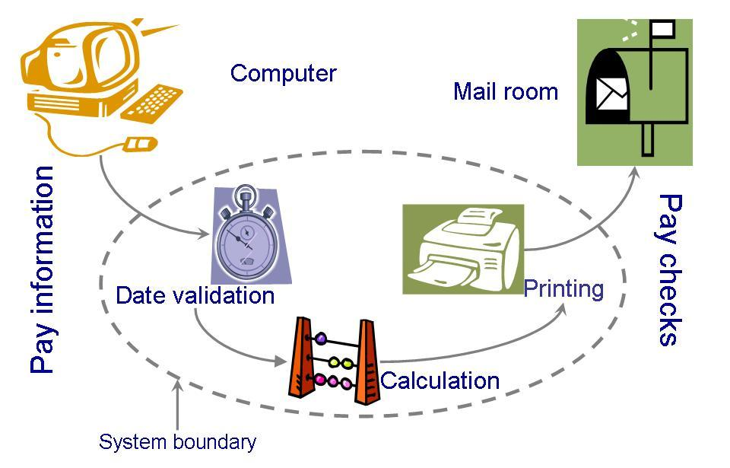
A Systems Approach (Contd.)
A computer system must also be clearly described: System definition of a paycheck production

Slide 30
An Engineering Approach
Idea to build a house
Asking someone to build the house
Explaining requirements
Getting designs
Modifying + Approving designs
Inspecting the construction
Adding new features
Testing household components
Moving in
Getting issues fixed after moving in
Building a House

Slide 31
An Engineering Approach
Determine and Analyze Requirements
Produce and Document Overall Design
Produce Detailed Specifications
Identify and Design Components
Build Components
Test Components
Integrate Components
Make final modifications after residents move in
Continue Maintenance by the Residents
Building a House

Slide 32
An Engineering Approach
Requirement analysis and definition
System design
Program design
Writing the programs
Unit testing
Integration testing
System testing
System delivery
Maintenance
Building a System

Slide 33
References
Shari Lawrence PFleeger and Joanne M. Atlee, Software Engineering Theory and Practice, Fourth Edition
Roger Pressman, Software Engineering: A Practitioner’s Approach
Ghezzi et al., Fundamentals of Software Engineering
Book slides from UCF
Acknowledgement
A few slides have been reused from UCF slides for the SE course

